Slide 1

USWDS Monthly Call
June 2022

Slide 2

Hi!
Thanks for being here!

Slide 3
Agenda
Site launches
Product updates
Our contribution model
Q&A

Slide 4
Site launches

Slide 5
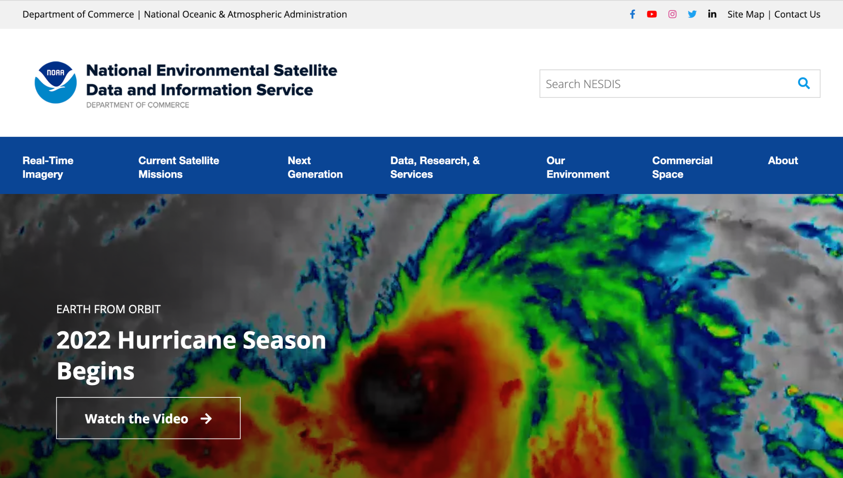
National Environmental Satellite Data and Information Service
nesdis.noaa.gov

Slide 6
Great work!

Slide 7
Product updates

Slide 8
USWDS 3.0.2

Slide 9
What’s new in USWDS 3.0.2 (1 of 4)
Custom background colors no longer can cause compile failures
More accurate automatic contrast checking for custom colors
Improves form group error state display

Slide 10
What’s new in USWDS 3.0.2 (2 of 4)
High resolution flag for the Banner
Megamenu always stays within the viewport
Improved display of dropdown menus in an error state

Slide 11
What’s new in USWDS 3.0.2 (3 of 4)
Improved target area for header dropdown links
Table border setting works as expected
uswds-init is better at suppressing FOUC

Slide 12


What’s new in USWDS 3.0.2 (4 of 4)
Improved Date Picker display at very narrow widths
Added a Fax icon to the default set
Added a Remove Circle icon to the default set

Slide 13
USWDS 3.0.2 Out tomorrow

Slide 14
USWDS Compile Beta 3

Slide 15
What’s new in USWDS Compile Beta 3
Improved icon sprite workflow. Now it’s easy to customize the sprite and keep it up-to-date with USWDS.
Fixed compatibility with M1 Macs and ARM-based silicon

Slide 16
USWDS Compile Beta 3
Out now

Slide 17
Contributing to USWDS

Slide 18
Elisa Chen
Design Strategist
18F/USWDS

Slide 19
Topics
What we’ve learned
What we’re trying
How you can contribute

Slide 20
But first, what are contributions?

Slide 21
Contribution (n.)
Brought together, added.
The giving or supplying of something as a part or share.
Source: Oxford Languages

Slide 22
When a community member gives back…
…enhancing USWDS by proposing a new
idea,
enhancement, or fix
that’s released through the system for other people to use.

Slide 23
TL;DR
It's a gift that keeps giving. ❤️ 🎁

Slide 24
Our role
Be good stewards of those gifts. 🌱

Slide 25
We did some research
Goals
Understand and document
who contributes and how
how we process contributions
Identify needs, pain points, and opportunities
Understand contribution best practices from other design systems
Approach
11 semi-structured user interviews
Desk research
GitHub analysis
other design system contribution models

Slide 26
The contribution journey
Deciding to contribute:
Should I contribute?
Contributing to USWDS:
How should I contribute?
Knowing next steps:
What will happen to my contribution?

Slide 27
What users need
Deciding to contribute:
Should I contribute?
Contributing to USWDS:
How should I contribute?
Knowing next steps:
What will happen to my contribution?
Feel confident
Have time
Know contribution is valuable for others/me
Know where to contribute
Know what to contribute
Know how to contribute
Find the right resources
Feel heard
Know what to expect

Slide 28
Pain points (Deciding to contribute)
Deciding to contribute
Should I contribute?
Contributing to USWDS
How should I contribute?
Knowing next steps
What will happen to my contribution?
Drop off point
Unsure if contributions are useful or helpful
Unclear if ideas are needed
Don’t know what USWDS priorities
Open communities can feel intimidating

Slide 29
Pain points (Contributing)
Deciding to contribute:
Should I contribute?
Contributing to USWDS:
How should I contribute?
Knowing next steps:
What will happen to my contribution?
Drop off point
Unclear how best to contribute
No clear starting point
Hard to finding contributing guidance
No clear pathways to propose feature requests

Slide 30
Pain points (Knowing next steps)
Deciding to contribute:
Should I contribute?
Contributing to USWDS:
How should I contribute?
Knowing next steps:
What will happen to my contribution?
Drop off point
Not knowing what to expect after contributing
Unclear on contribution status
Unclear on which feature requests are most needed (USWDS core team)

Slide 31
What we’re working on
Product roadmap
Contribution guide
Contributing website page
New issue templates
GitHub labels
Feature request backlog

Slide 32
I have an issue or idea…
Something’s not working properly:
bug
Something could work better:
enhancement
I want something that doesn’t exist:
feature request
Notes:
The journey of contributing can start in 3 places as they are working with the DS:
-User have a question - Why does this…?
- “” an issue and need help --- Hmmm.. this isn’t working right…
- “” have an idea - What if…
These starting points might lead to 4 main types of contributions we see now.
Our research mainly focuses on users who have an issue or an idea since these tend to have a more direct correlation with contribution.

Slide 33
Bug
How bugs get reported and fixed
Check for duplicate issues.
Document how to reproduce it.
Submit a bug report.

Slide 34
Feature request/enhancement
How a feature request gets into the design system
Check for duplicate issues.
If it already exists, upvote it.
If it doesn’t exist, submit a new feature request.
Check the roadmap for when feature requests/enhancements move into upcoming work.

Slide 35
Pull requests
How to submit a pull request
Check for duplicate issues
If the bug, feature request, or enhancement exists: Comment on the issue.
If the bug, feature request, or enhancement does not exist: Submit an issue (and PR, if it's a bug)

Slide 36
Anything else?
Submit an issue. Let’s chat.

Slide 37
How we prioritize
How we triage our work
Size: Can we accomplish this in a sprint or will it take longer?
Severity: What type of functionality is impacted? Is there a workaround?
Priority: Does this align with our vision and roadmap goals?

Slide 38
Demo

Slide 39
Other ideas we’re working on
How we’re continuing to improve our contribution model
Improve our contribution documentation
Propose content changes via USWDS website
Clarify ways to share other types of contributions, like research findings
Refine and document governance workflows
Track contribution metrics

Slide 40

Let’s continue the conversation
“What would make contributing easier for you?”
#uswds-public

Slide 41
Q&A

Slide 42
Next month
July: Summer vacation
#uswds-public
github.com/uswds
designsystem.digital.gov

